Slide 1

NALLA MALLA REDDY ENGINEERING COLLEGE
Autonomous Institution
Department of Computer Science & Engineering
2022-23
Major Project on
MediFit
Guide Details:
Mr. S. Ramchandra Reddy
Assistant Professor
Department of CSE
Team Members:
V. Sai Mukesh Reddy – 19B61A05F9
O. Srivalli Hrushitha – 19B61A05B3
K. Sai Narsimha Reddy – 19B61A0572
T. Venkata Giridhar – 19B61A05F4
Batch No. 4C3

Slide 2
Introduction
People today deal with a variety of diseases as a result of their lifestyle and the surroundings. As a result, it is crucial to predict diseases early on.
The hardest task is making an accurate diagnosis of a condition.
Our project aim is to predict diabetes and heart disease by utilizing machine learning algorithms.
Additionally, our system also provides personalized recommendations for nutrition and yoga poses to help manage the detected disease.

Slide 3
Problem Statement
There is a growing burden of lifestyle-related diseases such as diabetes and heart disease, which can often be prevented or managed through lifestyle interventions such as diet and exercise.
However, many people struggle to adopt and maintain healthy habits due to factors such as lack of knowledge, motivation, and social support.
The drawbacks of the existing system include cost, limited accessibility and lack of tailored recommendations.

Slide 4
Existing System
There are various existing systems and tools that are used for disease prediction and management, nutrition recommendations, and yoga therapy.
Telemedicine platforms: Telemedicine platforms allow users to connect with healthcare providers remotely, making it easier and more convenient to seek medical advice. These platforms can also provide users with tools to monitor their health at home and detect potential health problems early.

Slide 5
Existing System
Nutrition recommendation systems, such as MyPlate, ChooseMyPlate, and MyFitnessPal, which provide personalized recommendations for daily nutrient intake based on individual needs and dietary preferences.
Yoga therapy platforms, such as Glo, Yogaia, and Yoga International, which provide online classes and personalized recommendations for yoga poses and sequences based on individual needs and fitness levels.

Slide 6
Proposed System
Our proposed system is a machine learning-based platform that aims to predict the risk of developing diabetes and heart disease based on various input parameters.
The system also provides personalized recommendations for nutrition based on the medical conditions. It also provides Yoga courses for the user.
For example, the system might recommend specific foods or dietary interventions to help manage blood sugar levels for diabetes that are beneficial for reducing stress and improving cardiovascular health for heart disease.

Slide 7
Details of Modules
Logistic Regression: We are using Logistic Regression for heart disease prediction. Logistic Regression is a commonly used machine learning algorithm that works well for binary classification tasks such as heart disease prediction. It is a simple yet effective algorithm that is easy to interpret and provides good accuracy when used with appropriate feature selection and regularization techniques.
Support Vector Machine (SVM): We are using SVM for Diabetes prediction. SVM tries to find the best possible line (hyperplane) that separates the data points into different classes with the maximum margin between them.

Slide 8
Details of Modules
User Interface: The User Interface (UI) is a critical aspect of our project as it is the primary way for users to interact with the system. In the context of our project, a well-designed UI can help users easily input their medical parameters and receive disease predictions, food recommendations, and yoga tips.
PoseNet: We are using PoseNet to derive the parameters by tracking human pose. By using PoseNet, we can accurately detect yoga poses in real-time and provide feedback to the user based on their form and positioning.

Slide 9
Functional Requirements
The following are the functional requirements of MediFit:
Disease prediction: The system should be able to predict the risk of developing diabetes and heart disease based on user inputs
Yoga recommendations: The system should provide yoga routines and should be able to track the timer.
Yoga Pose classification: The system should be able to classify the estimated pose into a specific yoga pose from a pre-defined set of poses.

Slide 10
Non-Functional Requirements
The following are the Non functional requirements of MediFit:
Reliability: The system should be reliable and available 24/7, with minimal downtime or service interruptions.
Usability: The system should be user-friendly and easy to use for people of different age groups and technical backgrounds.
Accuracy: The system should be able to accurately predict and diagnose diseases, and provide appropriate recommendations for diet and exercise.

Slide 11
Application of the Project
Healthcare industry: Our project can be used in the healthcare industry to provide personalized healthcare solutions for patients suffering from diabetes and heart disease. It can also be used by healthcare professionals to monitor the progress of their patients.
Fitness industry: Our project can be used in the fitness industry to provide personalized fitness solutions for individuals. It can be used to create customized workout plans and yoga routines for people based on their health conditions.
Personal healthcare: Our project can be used by individuals to monitor their own health and fitness levels. They can use it to track their progress, set goals and get personalized recommendations for diet and exercise.

Slide 12
Hardware Requirements
Processor : Intel i3 or higher
RAM: 4GB or higher
Camera: Minimum 2MP
Software Requirements
Windows 8 or later.
Python programing language and all related packages.
VS Code

Slide 13
Testing and Implementation
Unit Testing: This involves testing individual components or modules of the system like classification of disease to ensure that each one works as intended.
Integration Testing: This involves testing how different modules or components of the system work together when integrated to ensure they function correctly as a whole. We tested whether the system is able to use the parameters provided by the user to give suggestions.
Usability Testing: This involves testing the system's user interface and user experience to ensure it is intuitive and easy to use for the target audience.
Acceptance Testing: This involves testing the system with a focus on meeting user requirements and expectations to ensure the system is ready for deployment.

Slide 14
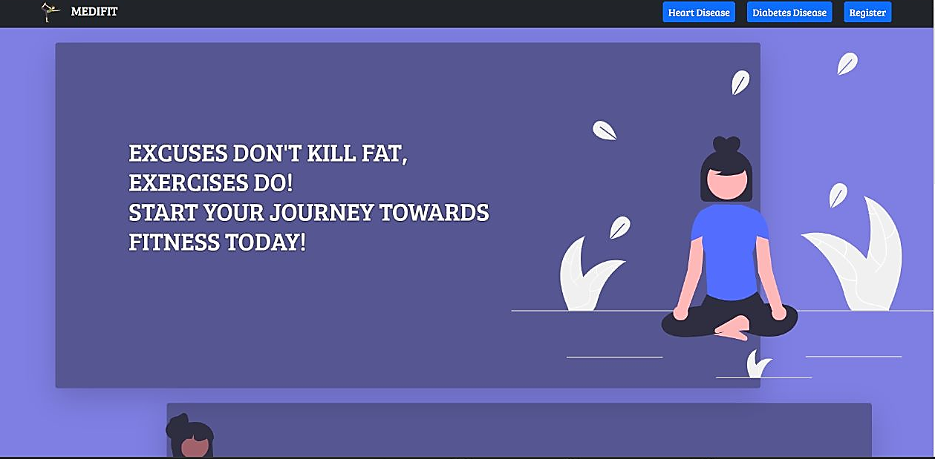
Results
Home Page

Slide 15
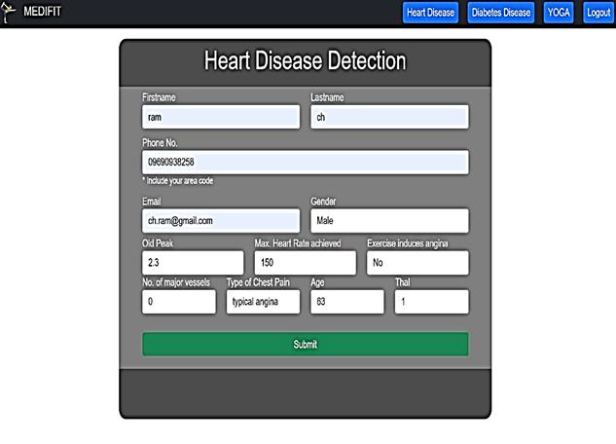
Results
Parameters Input Page

Slide 16
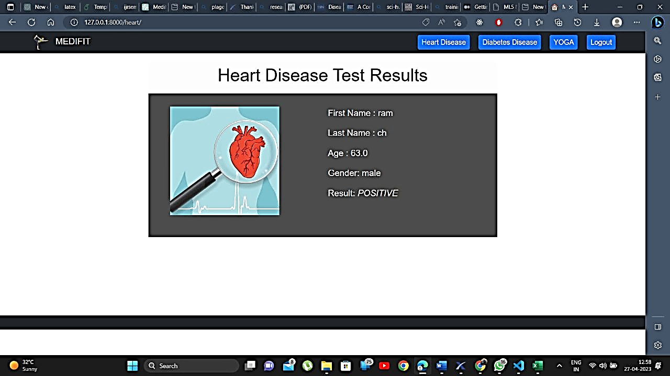
Results
Result Page

Slide 17
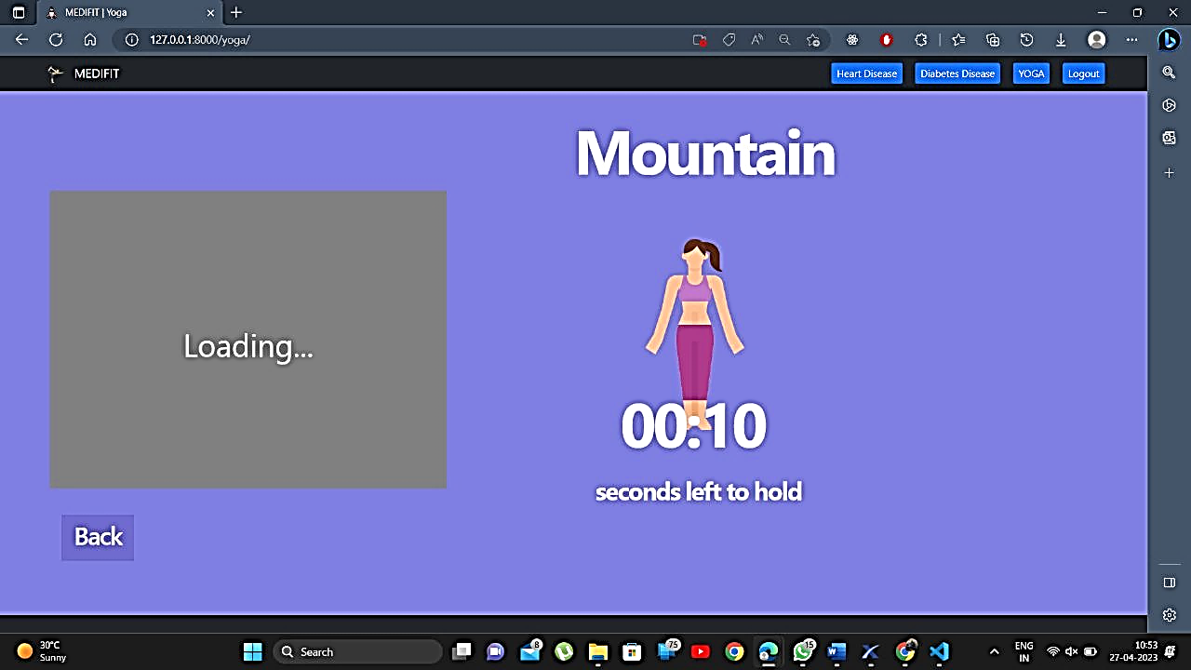
Results
Yoga Pose Detection Page

Slide 18
Conclusion
In conclusion, our project MediFit is a solution to predict and prevent diseases like diabetes and heart disease while providing customized yoga poses and food suggestions to users. It has been designed and implemented with a user-friendly interface, ensuring easy navigation and interaction with the application.
Our project comprises different modules, each with its unique functionality, including disease prediction, food recommendation, yoga pose detection, and user management. These modules work together to provide a comprehensive solution to our users.
MediFit has various real-life applications, including healthcare, fitness centers, and personal use. Our application can help individuals in maintaining a healthy lifestyle and reducing the risk of chronic diseases.

Slide 19
References
https://ijngc.perpetualinnovation.net/index.php/ijngc/article/view/208
https://www.mdpi.com/1424-8220/22/14/5304
https://www.hindawi.com/journals/jhe/2021/9930985/
https://www.irjet.net/archives/V10/i1/IRJET-V10I171.pdf
https://www.researchgate.net/publication/363331727_Surya_Namaskar_real-time_advanced_yoga_pose_recognition_and_correction_for_smart_healthcare
https://www.ncbi.nlm.nih.gov/pmc/articles/PMC3193654/
https://www.ncbi.nlm.nih.gov/pmc/articles/PMC1024880/pdf/brheartj00030-0006.pdf
https://journals.sagepub.com/doi/pdf/10.1177/193229681300700130

Slide 20
References
9.https://www.researchgate.net/publication/353016433_Disease_Prediction_and_Doctor_Recommendation_System_using_Machine_Learning_Approaches
10.https://www.researchgate.net/publication/306118434_Benefits_need_and_importance_of_daily_exercise
11. Analytical study of heart disease diagnosis using classification techniques | IEEE Conference Publication | IEEE Xplore
12.Survey of Heart Disease Prediction and Identification using Machine Learning Approaches | IEEE Conference Publication | IEEE Xplore
13.Strength Training: A Fitness Application for Indoor Based Exercise Recognition and Comfort Analysis | IEEE Conference Publication | IEEE Xplore
14.Prediction of Diabetes using Classification Algorithms – ScienceDirect
15.https://www.ingentaconnect.com/content/ben/cdr/2021/00000017/00000002/art00006

Slide 21
Thank You

